Slide 1
Machine Learning
Ensemble Techniques

Slide 2
Ensemble Methods
better predictive performance by combining the predictions from multiple models
Construct a set of multiple random base learners (classifiers/regressors) learned from the training data
Predict class label of test records by combining the predictions made by multiple classifiers/regressors (e.g., by taking majority vote, mean/median)
Bagging: fitting many decision trees on different samples of the same dataset and averaging/majority voting the predictions.
Boosting: adding sequential ensemble models that correct the predictions made by prior models and outputs a weighted average of the predictions

Slide 3
Necessary Conditions for Ensemble Methods
Ensemble Methods work better than a single base classifier if:
All base classifiers are independent of each other
All base classifiers perform better than random guessing (error rate < 0.5 for binary classification)
Rather than making one model and hoping this model is the best/most accurate predictor, ensemble methods take many models and reduces variance (Overfit to balanced-fit)
Custom/Voting Ensemble: Random row selection with Replacement; Multiple models, NOT all the models are decision tree
Random Forest: Random row and feature selection with Replacement; Multiple models, ALL the models are decision tree

Slide 4
Approach of Ensemble Learning (Bagging)
Bootstrap
Aggregate
Using majority vote or averaging
Random row selection with Replacement: Replacement means that if a row is selected, it is returned to the training dataset for potential re-selection in the same training dataset. This means that a row of data may be selected zero, one, or multiple times for a given training dataset

Slide 5
Constructing Ensemble Classifiers
By manipulating training set
Example: bagging, boosting, random forests
By manipulating input features
Example: random forests
By manipulating class labels
Example: error-correcting output coding
By manipulating learning algorithm
Example: injecting randomness in the initial weights of ANN

Slide 6
Bagging (Bootstrap AGGregatING)
Bootstrap sampling: random sampling with replacement
Build classifier on each bootstrap sample

Slide 7
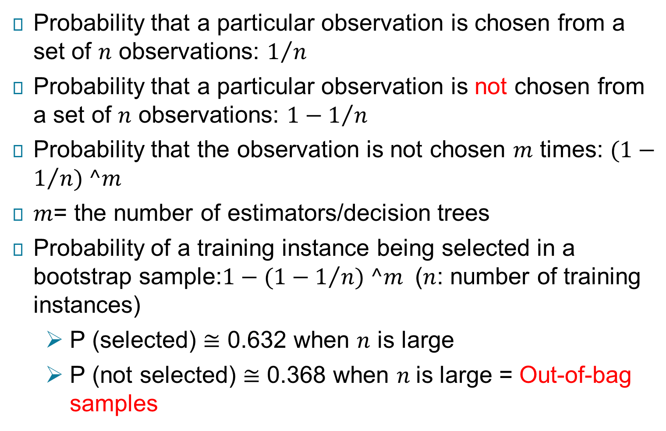
Bagging (Bootstrap AGGregatING)
Probability that a particular observation is chosen from a set of $n$ observations: $1/n$
Probability that a particular observation is not chosen from a set of $n$ observations: $1−1/n$
Probability that the observation is not chosen $m$ times: $(1−1/n) ^m$
$m$= the number of estimators/decision trees
Probability of a training instance being selected in a bootstrap sample:$1−(1−1/n) ^m$ ($n$: number of training instances)
P (selected) $≅$ 0.632 when $n$ is large
P (not selected) $≅$ 0.368 when $n$is large = Out-of-bag samples

Slide 8
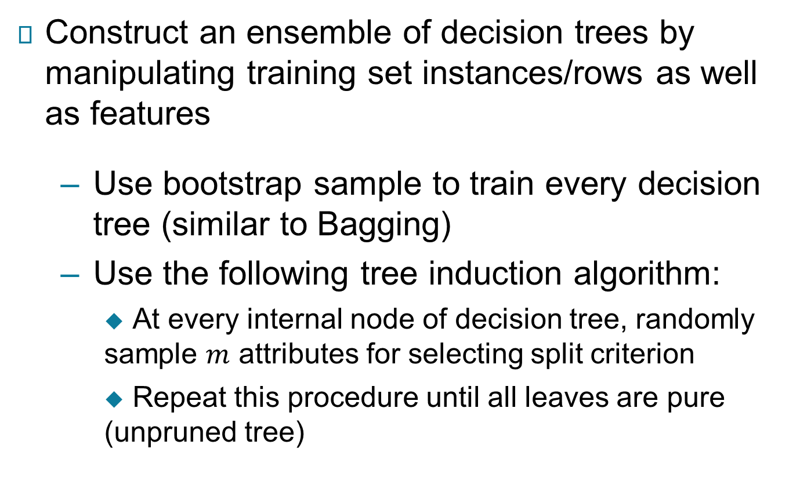
Random Forest Algorithm
Construct an ensemble of decision trees by manipulating training set instances/rows as well as features
Use bootstrap sample to train every decision tree (similar to Bagging)
Use the following tree induction algorithm:
At every internal node of decision tree, randomly sample $m$ attributes for selecting split criterion
Repeat this procedure until all leaves are pure (unpruned tree)

Slide 9
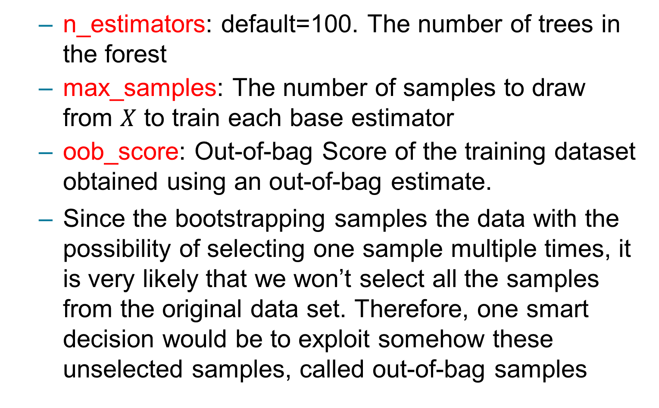
Random Forest Hyperparameters
n_estimators: default=100. The number of trees in the forest
max_samples: The number of samples to draw from $X$ to train each base estimator
oob_score: Out-of-bag Score of the training dataset obtained using an out-of-bag estimate.
Since the bootstrapping samples the data with the possibility of selecting one sample multiple times, it is very likely that we won’t select all the samples from the original data set. Therefore, one smart decision would be to exploit somehow these unselected samples, called out-of-bag samples

Slide 10
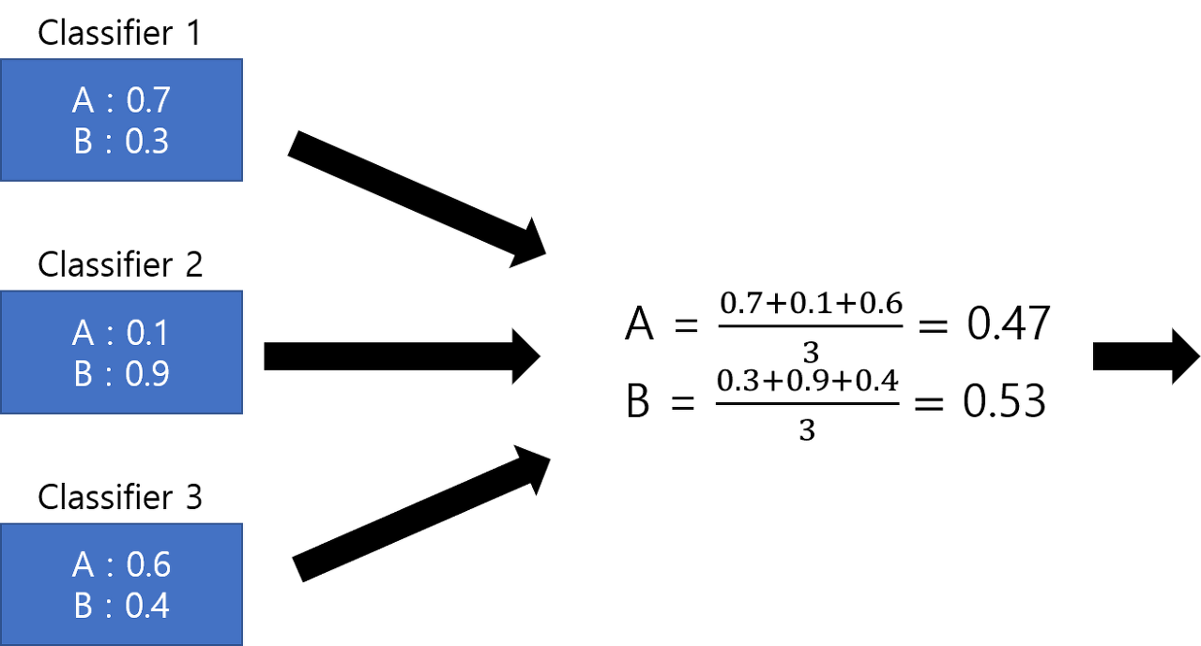




Hard and Soft Voting Classifier
In hard voting, we combine the outputs by returning the mode, i.e., the most frequently/majority voting occurring label among the base classifiers’ outputs
In soft voting, the base classifiers output probabilities or numerical scores
Soft voting classifier classifies input data based on the probabilities of all the predictions made by different classifiers
$$A$$
Predicted Output ($\tilde{y}$)
Hard Voting: $A$
Soft Voting: $B$
$$B$$
$$A$$

Slide 11
Boosting Algorithms
Boosting: sequential ensemble algorithms which converts weak/base learner to strong learners in series.
Step 1: The base learner takes all the distributions and assign equal weight/attention to each observation/sample.
Step 2: If there is any prediction error caused by first base learning algorithm, then we pay higher attention/weight to observations having prediction error. Then, we apply the next base learning algorithm. Second model/step is built which tries to correct the errors present in the first model.
Step 3: Iterate Step 2 till the limit of base learning algorithm is reached or higher accuracy is achieved. Complete training dataset is predicted correctly or the maximum number of models are added
Finally, it combines the outputs from weak learner and creates a strong learner which eventually improves the prediction power of the model. Boosting pays higher focus on examples which are misclassiﬁed or have higher errors by preceding weak rules.

Slide 12
Boosting Algorithms
Improved Accuracy – Boosting can improve the accuracy of the model by combining several weak models’ accuracies and averaging them for regression or voting over them for classification to increase the accuracy of the final model.
Robustness to Overfitting – Boosting can reduce the risk of overfitting by reweighting the inputs that are classified wrongly.
Better handling of imbalanced data – Boosting can handle the imbalance data by focusing more on the data points that are misclassified
Better Interpretability – Boosting can increase the interpretability of the model by breaking the model decision process into multiple processes.
AdaBoost (Adaptive Boosting)
Gradient Tree Boosting
XGBoost

Slide 13
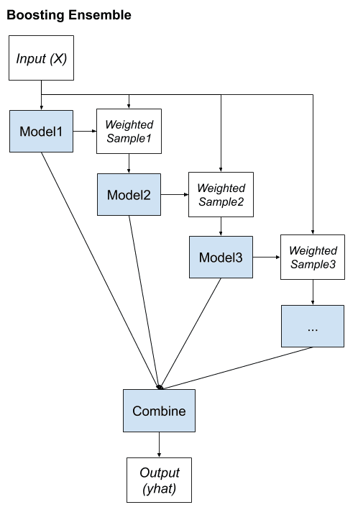
Approach of Ensemble Learning (Boosting)

Slide 14
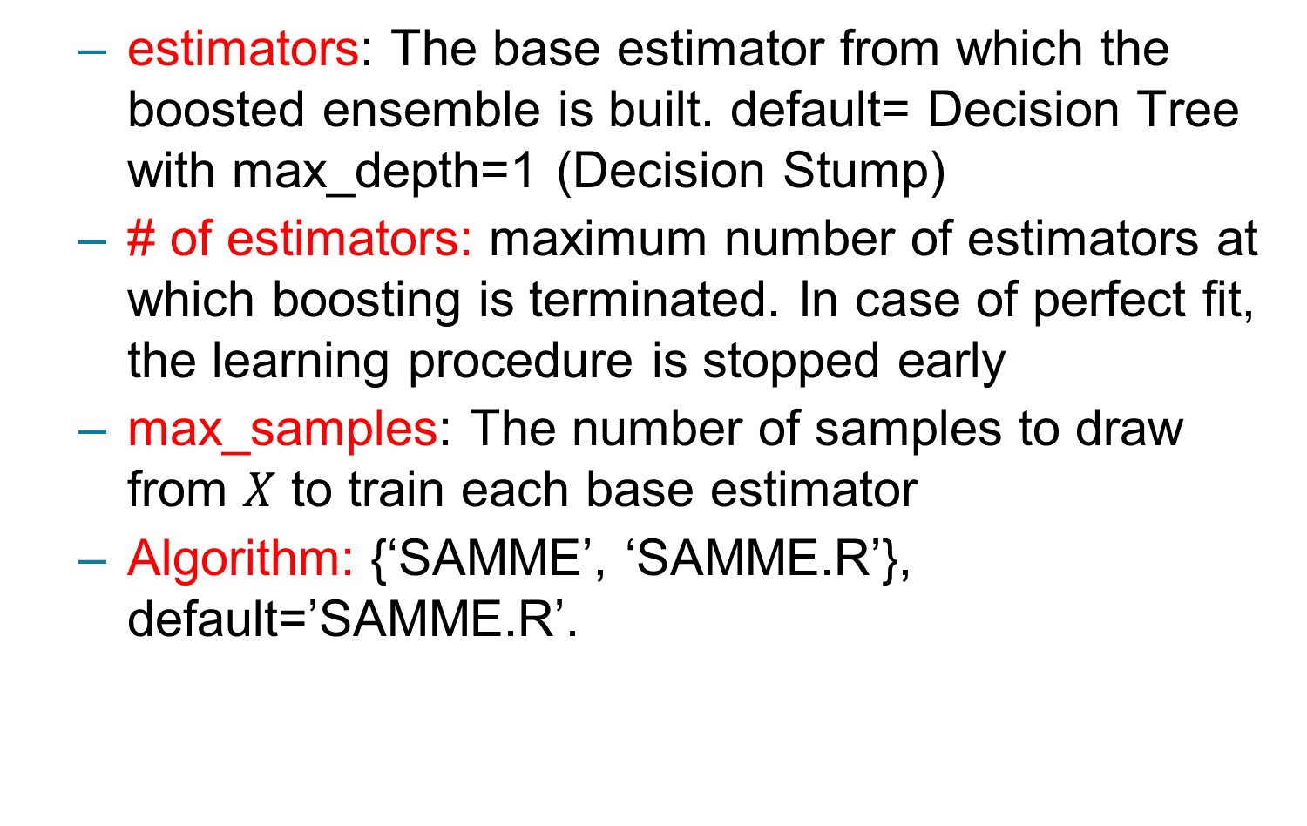
Boosting Hyperparameters
estimators: The base estimator from which the boosted ensemble is built. default= Decision Tree with max_depth=1 (Decision Stump)
# of estimators: maximum number of estimators at which boosting is terminated. In case of perfect fit, the learning procedure is stopped early
max_samples: The number of samples to draw from $X$ to train each base estimator
Algorithm: {‘SAMME’, ‘SAMME.R’}, default=’SAMME.R’.

Slide 15
Stacking and Blending Ensemble
Heterogeneous base/weak learners
Intermediate meta model from predictions of base
Train set is split into training and validation sets.
We train the base models on the training set.
We make predictions only on the validation set.
The validation predictions are used as features to build a new model.
Output of base learners are used to create a new dataset and meta learner
This model is used to make final predictions on the test set using the prediction values as features.
Step 1: Split the custom dataset into training, validation and test. Step 2: Train the multiple base models with the training samples.
Step 3: Generate the new dataset from predictions of base models with validation samples.
Step 4: Train the meta model with the new dataset.

Slide 16
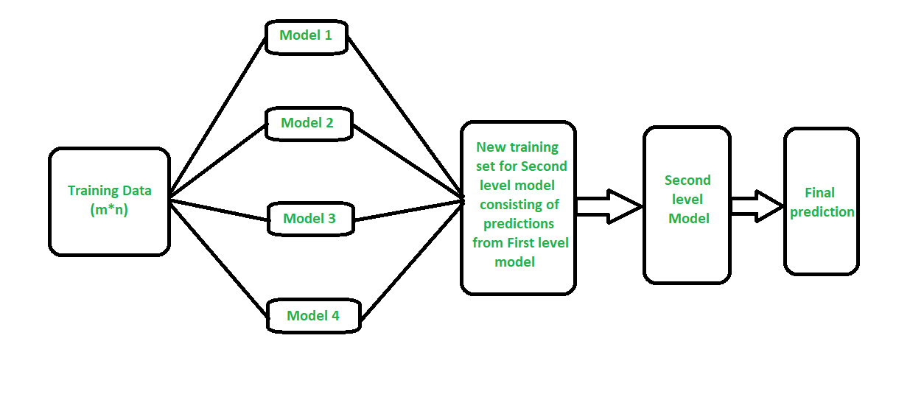
Stacking and Blending Ensemble
The difference between stacking and blending is that Stacking uses out-of-k-fold predictions for the train set of the next layer (i.e., meta-model), and Blending uses a hold out validation set (let’s say, 10-15% of the training set) to train the next layer

Slide 17
Stacking and Blending hyperparameters
Estimators: Base models
final_estimator: Meta model
CV: Number of folds
Passthroughbool: When False, only the predictions of estimators will be used as training data for final_estimator. When True, the final_estimator is trained on the predictions as well as the original training data.

Slide 18
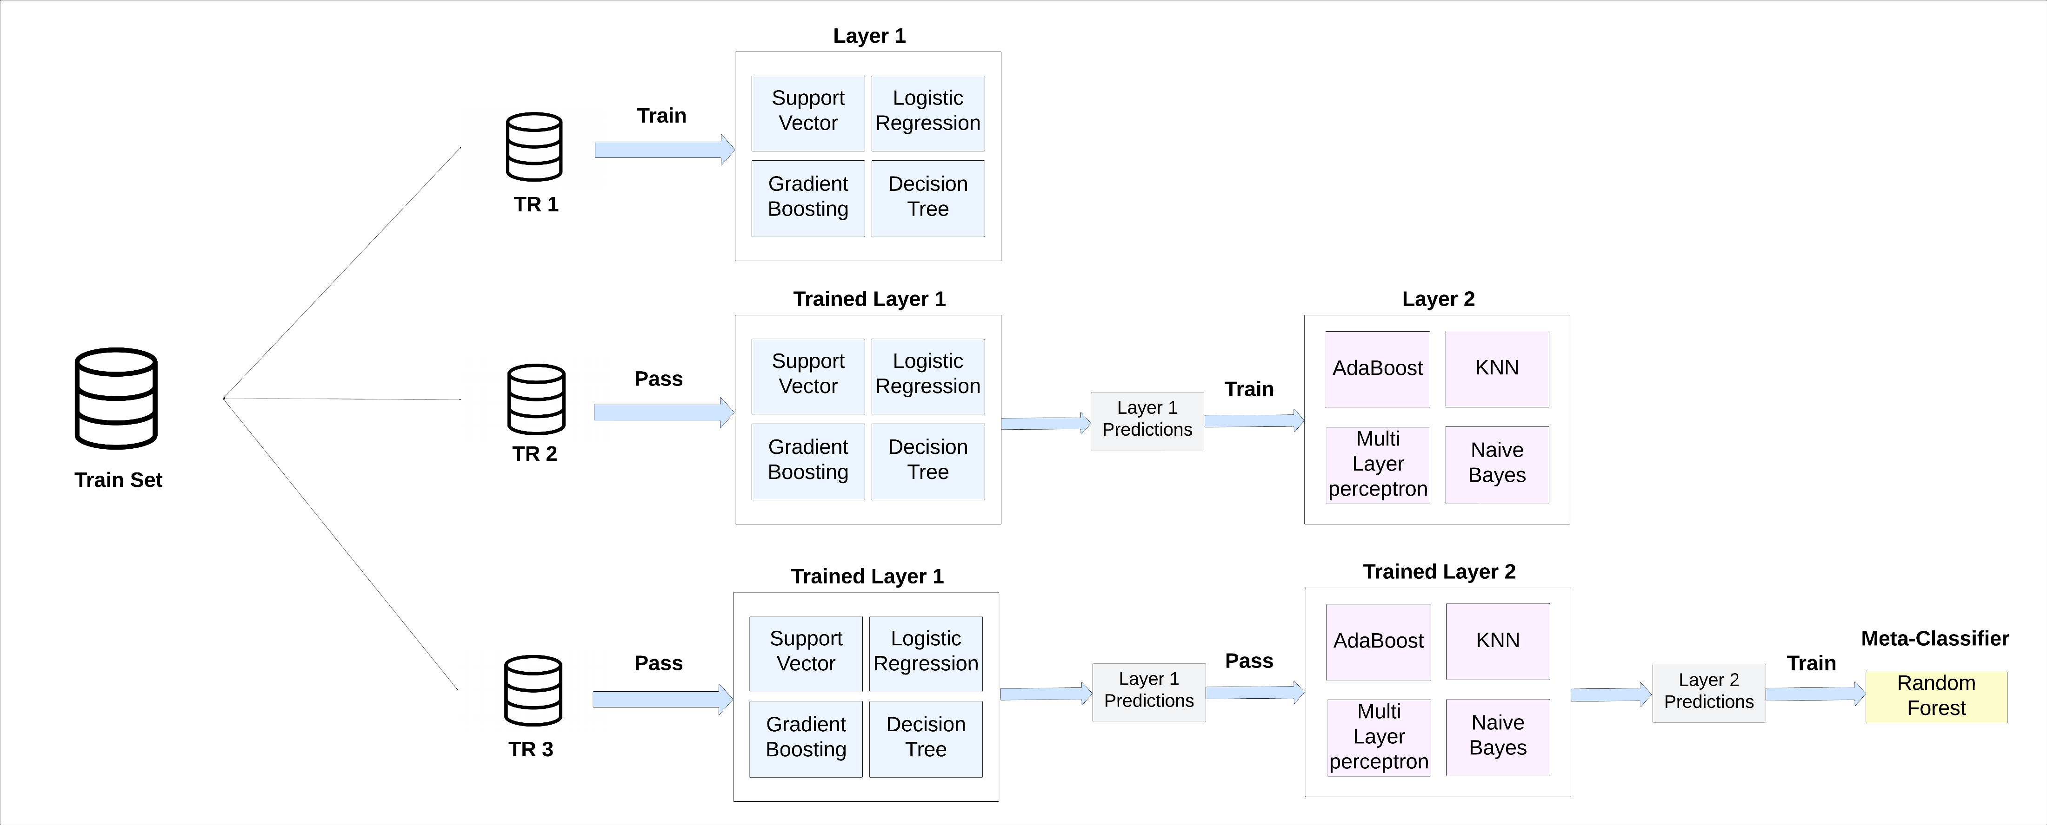
CSE498R
Multistage Blending/Stacking
https://www.nature.com/articles/s41598-024-77193-0#Sec10
https://ieeexplore.ieee.org/document/10298264

Slide 19
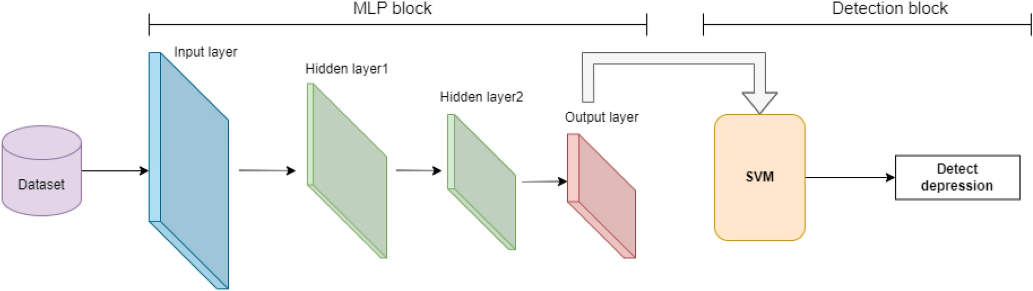
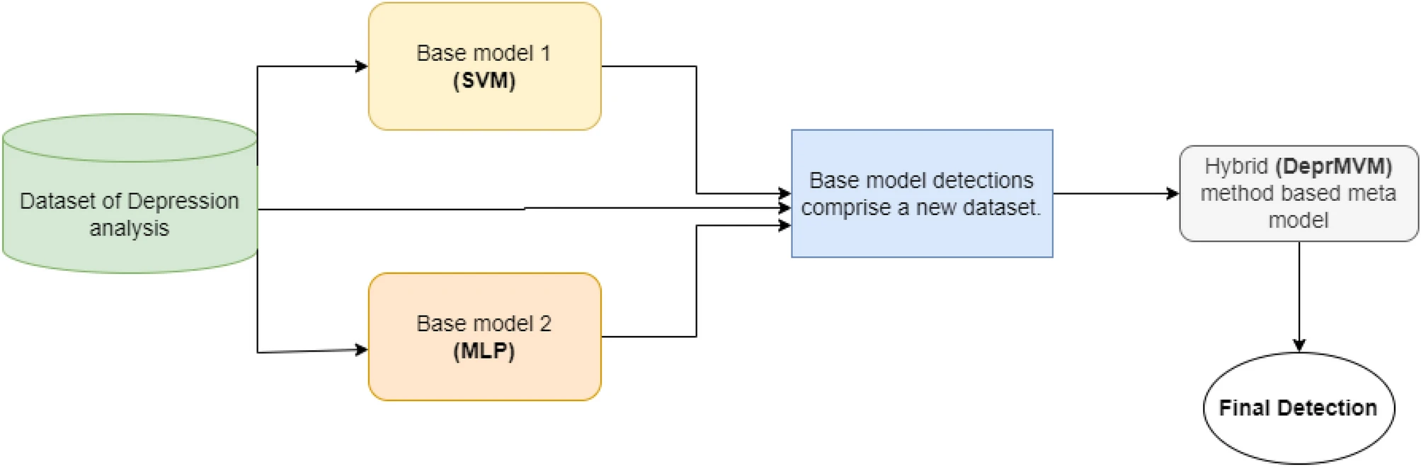
CSE498R
Ensemble of hybrid model- MLP-SVM

